Slide 1
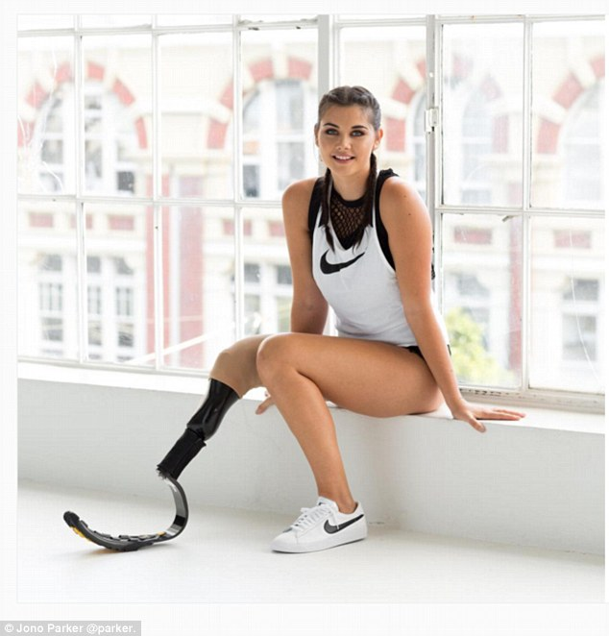
Problem Statement
Mental Trauma
Busy Parents
Discomfort from using prosthetic limbs
Co-confidential

Slide 2

Integrated Solution
Physical Comfort
Emotional Comfort
Co-confidential

Slide 3

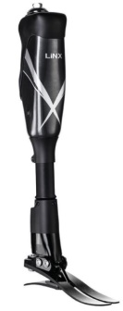
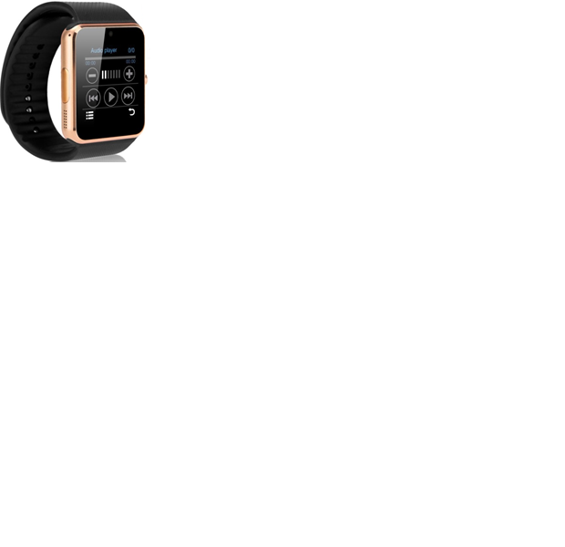

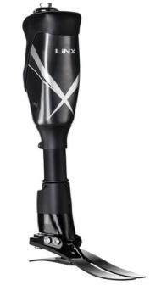
AI-powered Bionic Legs
Smart Watch
Sensation Simulation
24hr tracking and monitoring
Sensors to collect data
Fall Detection
Machine learning for
pattern recognition
Mood Analysis
Biomimetic
Hydraulic Technology
Counselling
Cycling mode
Scheduled Reminders
Fixed Angle Flexion
lock mode
Battery Life Indicator
and Low Power Mode

Slide 4
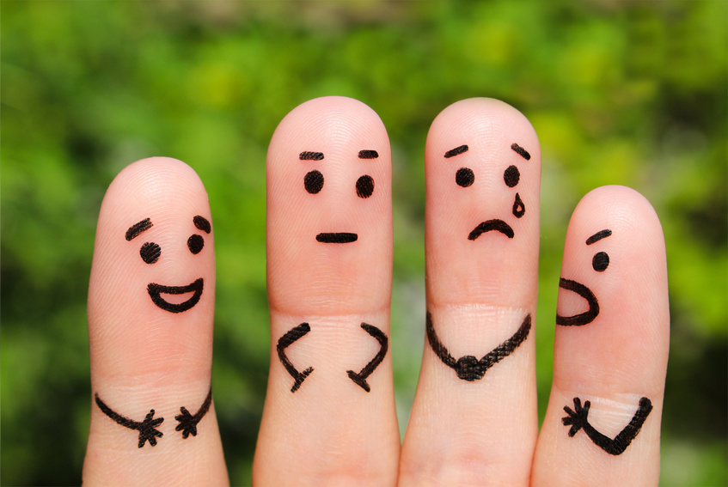
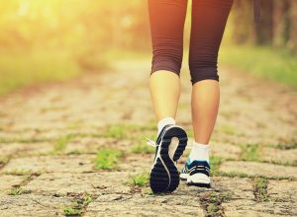
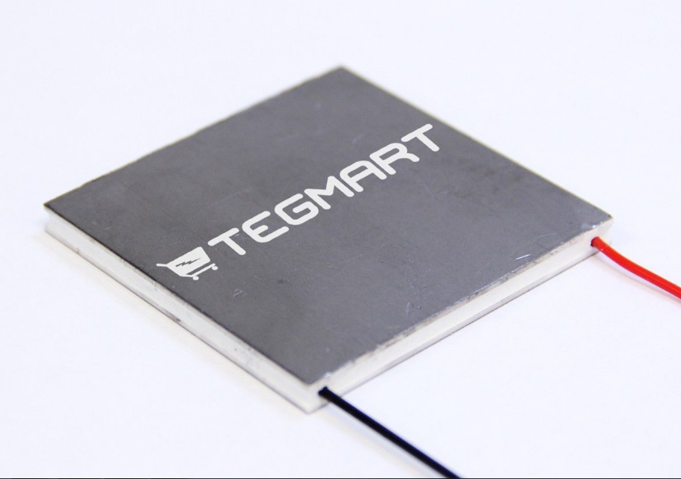
Holistic Tracking
Emotions
High emotional stress detection (Skin conductance, temperature, heartbeat rate, digital triaxial accelerometer)
Event tracker (GPS/GSM module and clock
Physical Movement
Fall detection (digital triaxial accelerometer)
Event tracker
Limb movement and walking pattern (digital triaxial accelerometer)
24hr tracking and monitoring
Co-confidential

Slide 5


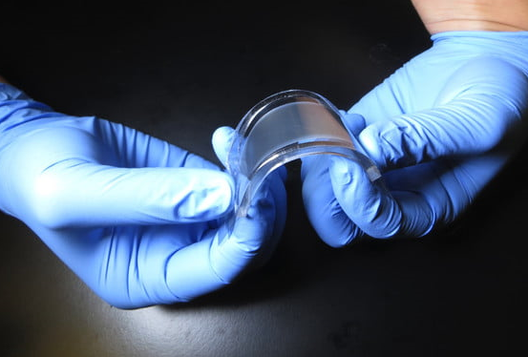
Holistic
Prescription
User
Prescribe soothing music
Prescribe breathing exercise
Prescribe couselling
Prescribe walking technique training
Caregiver
Notification of falls and high emotional stress
Reminder to chat with user
Prescriptions to both user ad caregiver based on past events and data
Co-confidential

Slide 6
APal
Total solution to walking again

